Slide 1

Data Models
Model – abstraction of a more complex real-world object or event
Data model – representation of complex real-world data structures
Data modeling – creating a specific representation for a determined problem domain
Importance
  Facilitates communication
  Provides various views of the DB
  Organizes data for various users
  An abstraction for creating a good DB

Slide 2
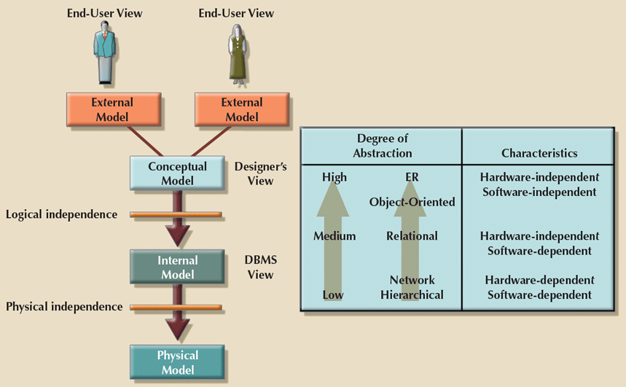
Degrees of Abstraction

Slide 3
Degrees of Abstraction
External Model
  End user’s view
  People use applications to manipulate data and generate information
  Represented by an ERD
  External schema – specific representation of an external view
Conceptual Model
  Global view (macro-level view) of entire database by the organization
  Conceptual schema – identification & high-level description of data objects
  Logical design – creating a conceptual model
  Represented by an ERD
  Software and hardware independent

Slide 4
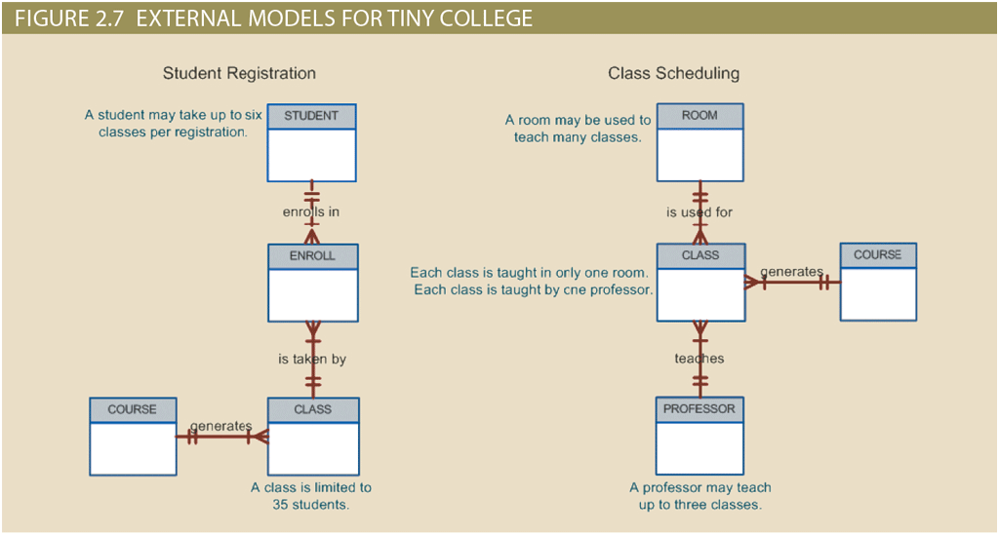
Degrees of Abstraction
External Model

Slide 5
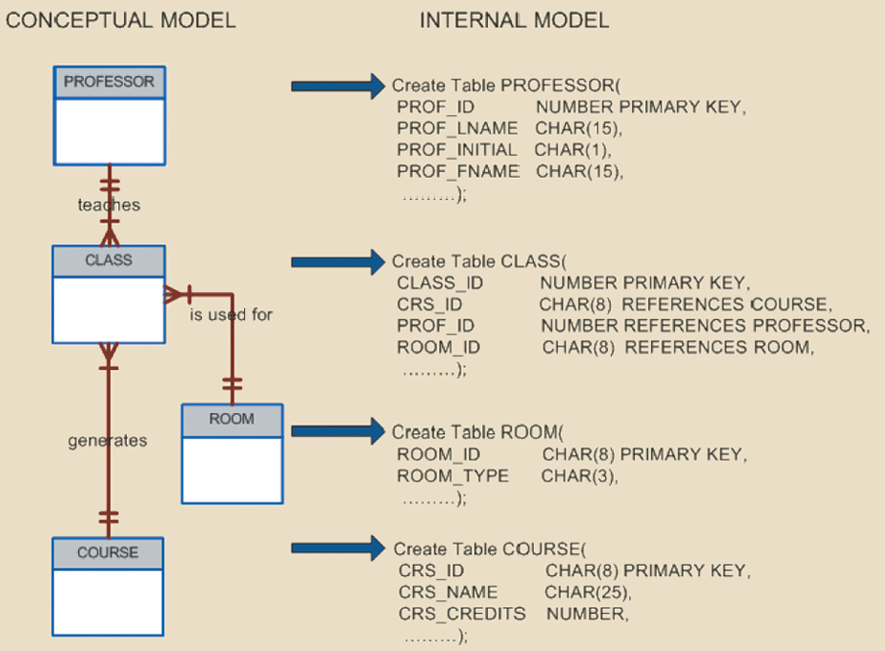
Degrees of Abstraction
Internal model
  Maps the conceptual model to the DBMS internal schema representation
  Internal schema
    Specific representation of an internal model
    Using constructs supported by the database
  Logical independence – changing the internal model doesn’t affect the conceptional model
  Hardware independent – unaffected by the type of hardware it is on

Slide 6
Degrees of Abstraction
Physical model
  Lowest level of abstraction
  Describes how data is saved on storage media
  Requires the definition of physical storage and data access methods
  Software and hardware dependent

Slide 7
Basic Building Blocks
Entity – person, place, thing, or event about which data will be collected and stored (think of a table)
Entity instance – one entity occurrence (think of a table row)
Attribute – characteristic of an entity (think of a table column)
  Attribute domain – set of possible values for an attribute
Relationship – association among entities (think of a link among tables)
Constraint – restriction placed on data to ensure data integrity

Slide 8
Relational Model
Relation – matrix composed of intersecting tuples and attributes
  Relation – table or entity
  Tuple – row, entity occurrence, or entity instance
  Attribute – column or characteristic
Relationship - association among relations (connectivity)
  One-to-many (1:M)
  Many-to-many (M:N)
  One-to-one (1:1)

Slide 9
Business Rules
Description of a policy, procedure, or principle
Brief, precise, and unambiguous
Create and enforce actions within that organization’s environment
Standardizes the company’s view of data
Facilitates communication between users and designers
Assists designers to
  Understand the nature, role, scope of data, and business processes
  Develop appropriate relationship participation rules and constraints
  Create an accurate data model
Establishes entities, relationships, and constraints, and processes

Slide 10
Business Rules
Translating business rules into data model components
  Nouns → entities
  Verbs → relationships between entities
  Adjectives of the relationship → relationship type and cardinality
  Characteristics of a noun → entity attributes
  Descriptions of a characteristic → attribute constraints and domains
  Descriptions of events that occur involving entities → process
  Descriptions of events that occur involving the DBMS → process
Note: Need to think carefully about the context to understand how to use the business rule in designing

Slide 11
Business Rules Examples
A customer may generate many invoices.
  Customer and invoice are entities
  Generate is the relationship
  May generate many – 1:M (technically 0:M)
An invoice is generated by only one customer.
  Invoice and customer are entities
  An invoice generated by only one – 1:1
A customer has an ID of nine digits, first name, last name, phone number.
  ID, first name, last name, phone number are entity attributes
  ID attribute domain is a value between 100000000 to 999999999
  Others may be implied by or need clarification, e.g., name and phone number

Slide 12
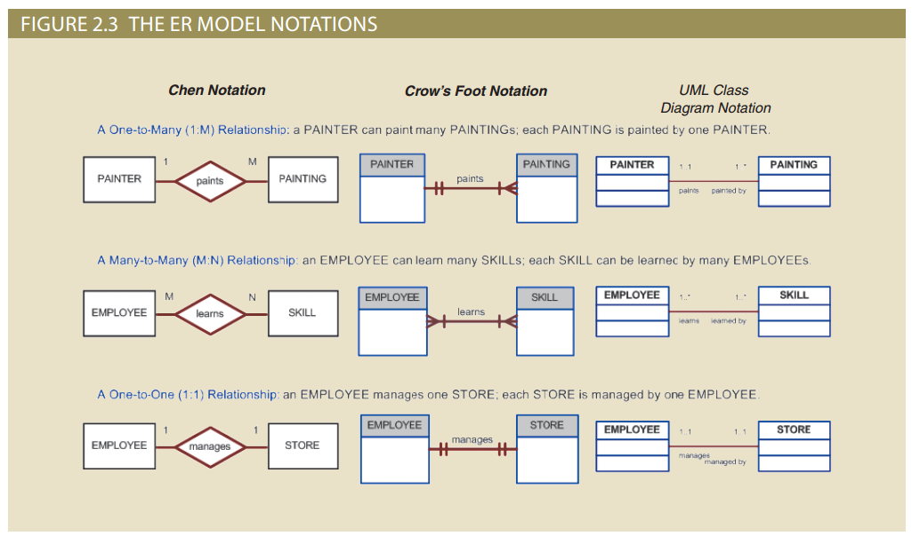
Business Rules Examples
A painter paints many paintings.
Each painting is painted by one painter.
An employee learns many skills.
Each skill can be learned by many employees.
An employee manages one store.
Each store is managed by one employee.

Slide 13
Business Rules Examples
A transfer subtracts money from one account and adds it to one other
  Process that updates two different accounts, leaving them in balance
The maintenance schedule is every Saturday beginning at 6 am CST
  Process that entails some type of maintenance to the system
  Constrains the maintenance to start on Saturday morning
Note: There are often hidden constraints and vagueness that need defining, questions that need answers, and details that are missing.

Slide 14
Business Rules Naming Conventions
Proper naming is important
  Facilitates communication between parties
  Promotes self-documentation
  Be descriptive of the item
  Use terminology familiar to the users
It does not matter what you think something should be named because you must match what the organization uses.

Slide 15
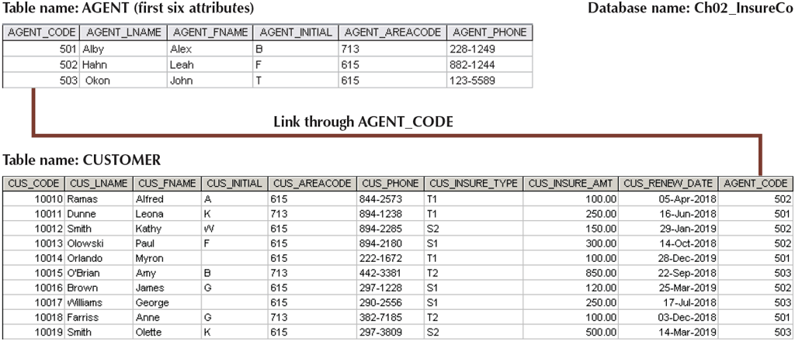
Business Rules – Writing Examples
Write the business rules that govern the relationship between an agent and a customer.

Slide 16
Business Rules – Writing Examples
One agent can have many customers.
Each customer has only one agent.

Slide 17
Business Rules – Writing Examples
An agent has a numeric code, last name, first name, middle name initial, and a phone number with area code.
Agent code is a three-digit integer. (right justify suggests number)
Name are strings of variable length with unknown length limit.
Middle name initial is one character.
Area code is a three-digit string without parentheses. (left justify)
A phone number is a string formatted as three-digits followed by a dash and four digits.
Other business rules?
Notice our assumptions?

Slide 18
Business Rules – Writing Examples
The local city youth league needs a database system to help keep track of children who sign up to play soccer. It must hold data on each team, player, coach, and guardian. A team has an ID, name, and team colors. A player has an ID, first name, last name, and age. A coach has an ID, first name, last name, and phone number. A guardian has an ID, first name, last name, address, and phone numbers for home and cell phones. Note that the guardian does not require both phone numbers, but they must have at least one of them.
A player can only play for one team. While we typically assume that a team must have players, it is possible that a team temporarily has no players and a maximum of 15 players. It is possible that a team temporarily does not have a coach, but if there is a coach, the coach can only be on that team. A team can have up to three coaches.
The player must have at least one guardian but can have up to two. Several players can have the same guardians, and those players could be on the same team.

Slide 19
Business Rules – Writing Examples
A team has an ID, name, and team colors.
A player has an ID, first name, last name, and age.
A coach has an ID, first name, last name, and phone number.
A guardian has an ID, first name, last name, address, and home and cell phone numbers.
A team has many players. A player is on one team.
A team is coached by many coaches. A coach coaches one team.
A player has many guardians. A guardian can have many players.
A team has 0 to 15 players.
A team has 0 to 3 coaches.
A player must have 1 to 2 guardians.
Related players can be on the same team.
A guardian must have a home number, cell phone number, or both.
Others?
How correct are they?

Slide 20
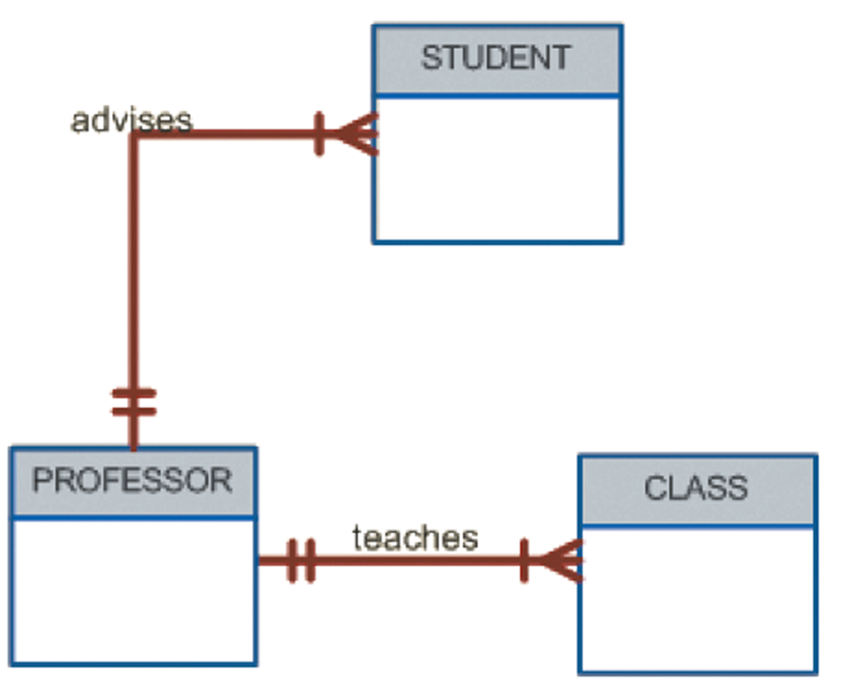
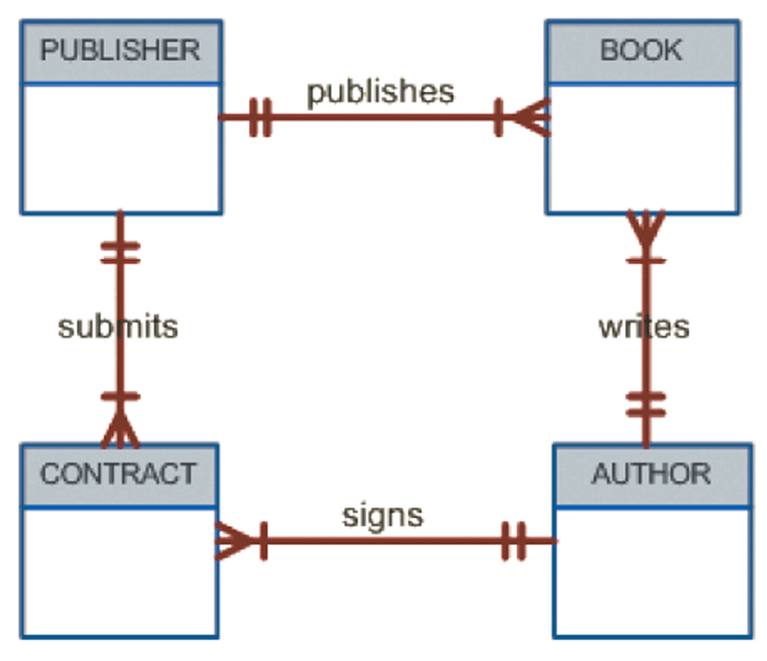
Entity-Relation Diagrams (ERD)
Business rules help us design the database.

